Slide 1
Unit V - Embedded GPU Design
CSPC61 - Embedded Systems Architectures
Dr. M. Bhuvaneswari
25.04.2022

Slide 2
Introduction
Graphics Processing Units (GPUs) have become an important part of modern high-performance computing system.
GPUs are purpose-built devices designed to accelerate graphics rendering.
GPUs have been used on high-end computer systems to perform general-purpose computing across various domains of applications.
Proliferation - high-performance embedded systems, GPUs uses in the design of embedded systems.
Low power embedded system featuring a GPU can run algorithms that would require a large quantity of top-tier CPUs.
Emerging complex systems (autonomous vehicles) request for large amounts of processing power.
Insatiable need for throughput - power- and time-related constraints - Design of embedded GPU systems as a challenging task.

Slide 3
GPU Computing
GPUs are specialized computing devices originally designed to accelerate complex graphics rendering calculations.
A GPU comprises a large number of processing cores each responsible for manipulating a single pixel of an image frame intended to be displayed on the screen.
To keep the power consumption of a GPU within a tolerable limit, the cores run at a lower clock frequency than a CPU.
GPU delivers a much higher throughput than its CPU
a pool of cores operating on different pixels in parallel.
a high-bandwidth memory system, as compared to the low-bandwidth CPU memory.
GPUs as computing platforms to run scientific applications unrelated to graphics.
general-purpose computing on GPUs (GPGPU)

Slide 4
GPU Computing
Workflow of a GPGPU program, the following steps,
(a) the host (CPU) transfers the data to the GPU memory
(b) the GPU processes the data, freeing up the CPU to take care of the more sequential and control-oriented segments of the code
(c) the CPU initiates a read-back process to transfer the results from the GPU memory to the host memory.
Applications
Video/image processing, Mobile gaming
Medical imaging, Computer Vision
Financial modeling
Scientific computing, neural networks
Cryptocurrency, Packet processing
2013 - embedded systems adopt the GPGPU technology to address the increasing demand for computing capability.

Slide 5
Embedded GPU Design
The research on programming frameworks and tools aims to facilitate the design process and help identify the bottlenecks of the system.
Studies on hardware architecture provide better design for different parts of the GPU and its memory system.
It offers great performance improvements, but they are often costly and hard to deploy.
System input can be modeled by one or more data streams. Each data instance - an item.
Important attribute - Items of a stream may arrive at a fixed or dynamic rate.
Every item - arrival rate and the stream - timeliness. It may vary depends on different applications.
Design of embedded GPGPU, embedded systems are usually faced with multiple sources of latency, throughput and power-related issues.
In design phase - conflicting objectives - accumulating multiple items to increase the energy efficiency of the GPU, but it increases the average latency per item

Slide 6
Embedded GPU Design Challenges
Graphics rendering, reducing the frame size lowers the energy consumption, but it results in a lower image quality.
Most high-end GPGPU applications do not have a per-item latency requirement, rather they aim to reduce the overall application duration.
Although power consumption is an important performance metric in high-performance computing, it is not as much a limiting factor in embedded system design.
High-performance embedded systems have the access of to the continuous power supply.
A high and low-level design deals with optimizing performance
To overcome challenges, it is required to optimize the design both at the low and high level.
A low-level design deals with optimizing performance with respect to a particular system component.
A high-level design are not visible at the component level (flow of information and the interrelation between the components).

Slide 7
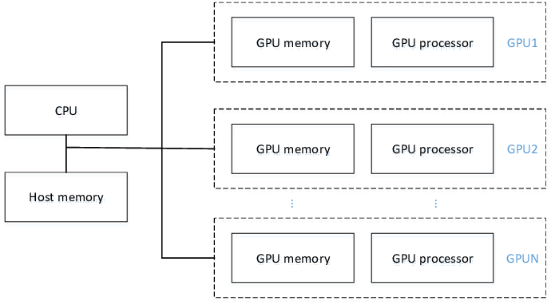
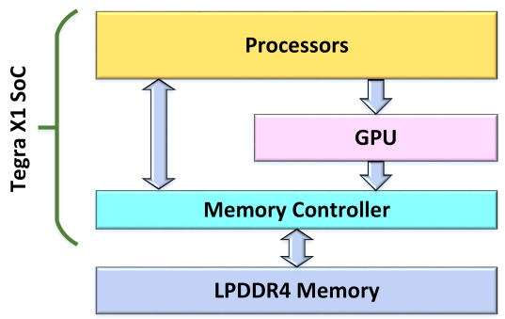

Components of GPU Embedded Systems
Nvidia Jetson TX1 – GPU Embedded System. It is a system-on-module (SoM) combining the Nvidia Tegra X1 SoC with 4GB LPDDR4 memory.
Nvidia Tegra X1 SoC consists of a Maxwell GPU with 256 CUDA cores, 1.6GHz/s, 128K L2 cache, and 4 channel x 16bit interface to access the system memory.
CUDA language - GPU implementation - NVIDIA Performance Primitives library is used.
A heterogeneous embedded system is composed of a general-purpose central processing unit with an enhanced module of graphics processing units (GPU).

Slide 8
GPU-based programming languages & Platforms
Brook for GPUs
Stanford University - programming language for “streaming processors”
Researchers adapted Brook to make GPU based systems.
Brook extends the C programming language by streams.
Streams - a “collection of elements” where each element is manipulated by the same computations.
Streams are different from “arrays”, because there is no index operation and element dependencies are not allowed.
System development with Brook is a two-stage process: Once the program is developed, its compilation results in a set of C++ files that can be added to the host application.

Slide 9
GPU-based programming languages & Platforms
CUDA (Compute Unified Device Architecture) environment.
Standard C programming language is extended to support streaming types and corresponding operations.
CUDA can be used as a unified environment to develop applications for both processor platforms – CPU and GPU.
CUDA framework also includes libraries for linear algebra (BLAS) and digital signal processing (FFT)
CTM – “Close-to-the-Metal”
ATI introduced the CTM platform - a data parallel virtual machine that allows direct communication with ATI graphics devices and graphics API.
CTM is used to access graphics hardware on a very low level. It has been designed for hand-optimized tuning the GPU-based functionality.

Slide 10
Embedded Language and Libraries
Smash testbed developed at the University of Waterloo. Sh is a pioneered embedded GPU programming
It has limited instruction set of the available GPUs.
Massive use of macros and the lack of object-oriented features, development of Sh stopped.
RapidMind Development Platform (RMDP)
It is the commercial successor of the Sh library
It is not only support graphics-oriented and it also supports the Cell Broadband Engine as a target processor.
It used as an attractive development platform for GPGPU programming.

Slide 11
Embedded Language and Libraries
PeakStream Platform
It uses the “expression template” approach for embedded programming of the GPU
It works on Linux and extends the GCC or Intel compilers. Hence debugging and profiling the GPU-based code is fully supported.
Accelerator
It is the second programming library for graphics hardware from Microsoft.
It integrates into most of the languages available as part of the .NET framework.
The common .NET just-in-time compilation generates CPU- or GPU-based code at run-time.
Similar to the PeakStream Platform, Accelerator does not support kernel synthesis.
It uses special array types (data parallel array) for GPU-based computations.
Data-parallel arrays are different to normal memory arrays, because they lack of specific features (e.g. aliasing, pointer arithmetic, and the access of individual array elements).

Slide 12
Unit V - Embedded Computing System on FPGAs
CSPC61 - Embedded Systems Architectures
Dr. M. Bhuvaneswari
25.04.2022

Slide 13
Introduction
New embedded systems demand new features.
Efficiently working with Internet
Enabling highly computational power
consuming low energy
providing real-time at the scale of machinery with nanosecond latency and
working collaboratively with other similar systems to finish a shared task.
As advanced algorithms continue to emerge for smart product designs.
Developers struggle to implement embedded systems - able to meet the associated processing demands of these algorithms.
Availability of more powerful FPGAs (Field Programmable Gate Arrays) and more effective development environments has made FPGA based embedded system development broadly accessible.
Heterogeneous embedded systems (FPGA and GPU) are promising techniques to cope with the increasing demands.

Slide 14
Introduction about FPGA
It is an integrated circuit that implements code in hardware to execute a thousand times faster than in a processor.
It consists of configurable logic blocks (CLBs), memory, or other elements.
A gate array is a digital integrated circuit containing a large number of logic elements that can be connected in an arbitrary manner to form complex digital devices.
A microcontroller or microprocessor implemented using the gates of an FPGA is referred to as a soft processor.
Early versions of gate arrays were one-time programmable devices. Once a device had been programmed, it could not be changed.
The technology of gate arrays has improved and now reprogrammable gate arrays are widely available.
FPGAs are gate arrays that can be reprogrammed at any time, even after an embedded system has been assembled and delivered to its end user.

Slide 15
Elements of FPGAs
The digital parts available within an FPGA - lookup tables, flip-flops, block RAM, and DSP slices.
Lookup tables are used extensively in FPGAs to implement combinational logic circuits constructed from simple logic gates such as NOT, AND, OR, and XOR, as well as NAND, NOR, and XNOR.
Implementing a logic gate circuit in hardware with the actual gates in its design, it is always possible to represent the same circuit using a simple lookup table.
A typical FPGA lookup table has six single-bit input signals and a single bit output.
This is equivalent to a single-bit-wide memory device with six address inputs holding 64 bits of data.
A flip-flop is a high-speed single-bit memory storage device.
As with lookup tables, FPGAs contain large numbers of flip-flops to support the construction of complex sequential logic circuits.

Slide 16
HDL and Benefits of FPGAs in Embedded system
A Block RAM (BRAM) is a range of dedicated memory locations within an FPGA.
FPGA synthesis tools allocate BRAM to circuit designs in a manner that optimizes the performance of the digital circuit.
DSP slices is used to perform the central computation of digital signal processing.
The process of converting the high-level description of device functionality into the allocation and interconnection of the lookup tables, flip-flops, BRAM, and other device components is called FPGA synthesis.
Hardware Design Languages - VHDL and Verilog
VHDL – VHSIC (Very High-Speed Integrated Circuit) Hardware Description Language.
VHDL - Ada programming language. Verilog has capabilities similar to VHDL.
Processor customization, Flexible peripheral configuration, High-level synthesis, Hardware acceleration for parallelizable applications, Extensive debugging capabilities and Rapid prototyping of ASIC designs - benefits of using FPGAs in Embedded system

Slide 17
Embedded Systems Design with FPGA
Low End FPGAs - low power consumption, low logic density, and low complexity per chip
Spartan family from Xilinx
Cyclone family from Intel
Mach XO/ICE40 from Lattice Semiconductor
Fusion Family from Microsemi.
Mid-Range FPGAs - Designed for optimum solution between the low-end and high-end FPGAs
Arria from Intel
IGL002 from Microsemi
Artix-7/Kintex-7 series from Xilinx
ECP3 and ECP5 series from Lattice semiconductor.
High End FPGAs - Designed for logic density and high performance.
Virtex family from Xilinx
Speedster 22i family from Achronix
Stratix family from Intel
ProASIC3 family from Microsemi

Slide 18
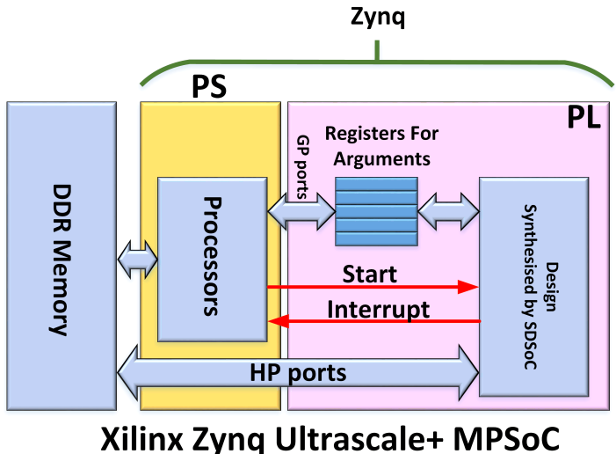
Components of FPGA Embedded Systems
Xilinx Zynq MPSoC– FPGA Embedded System. It consists of two parts: Processing System (PS) and Programmable Logic (PL). It has a direct access to the system DDR memory.
PL performs its memory transaction through a few high-performance ports (four HPs, two HPCs, and an ACP ports).
Four HP ports can collaboratively transfer data between FPGA and memory, utilizing all the memory bandwidth available to the FPGA.
C++ language and the Xilinx SDSoC toolset
are used for the FPGA implementation which
is based on the streaming pipelined computing
approach.

Slide 19
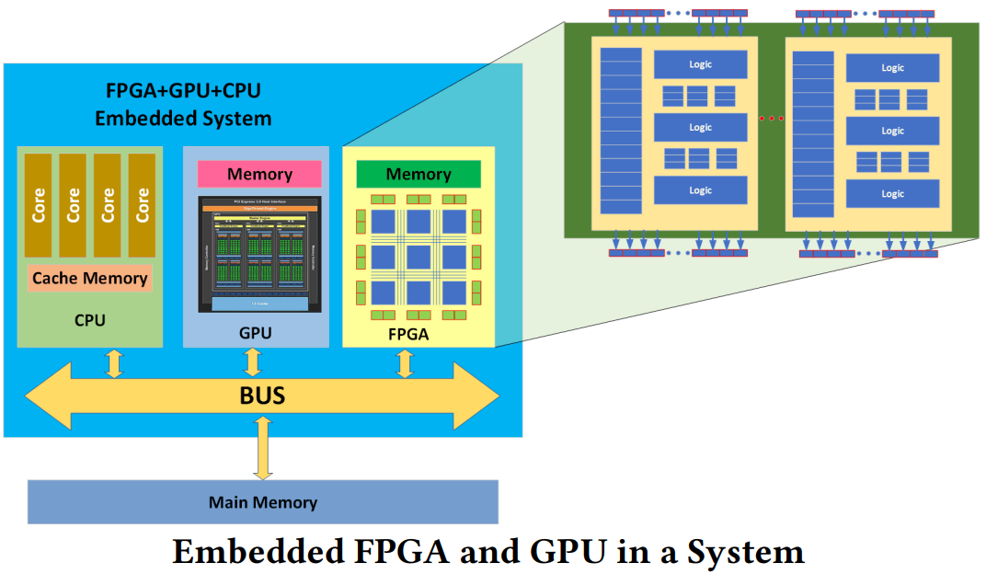
Heterogeneous Embedded System
An embedded system consisting of three processing elements (PEs) including a multi-core CPU, a many-core GPU and an FPGA.
Main feature of the architecture is the direct access of PEs to the main memory using the same address space and shared memory controller.

Slide 20
Development Process
To develop FPGA based embedded systems - a set of development steps
Defining system requirements - what the system is supposed to do, system’s intended functionality, operating modes, and key features.
Allocating functionality to the FPGA - allocating overall system requirements to the FPGA device.
Identifying required FPGA features - low-cost, less-complex, devices might operate from battery power and require only passive cooling or large-scale, full-featured digital designs, active cooling
Implementing the FPGA design - FPGA development tool suite consists largely of developing HDL or C/C++ code in the preferred language
Design entry - the system developer defines system functionality using HDL code, block diagrams, and/or C/C++ code.

Slide 21
Development Process
To develop FPGA based embedded systems - a set of development steps
I/O planning - process of identifying the pins assigned to perform particular I/O functions
Synthesis - It transforms the source code into a circuit design called a netlist. The netlist represents the circuit constructed from the resources of the target FPGA model. It represents a logical, or schematic, version of the circuit.
Place and route - place process takes the FPGA resources defined in the netlist and assigns them to specific logic elements within the selected FPGA. A set of connections among the logic elements is configured during the route process
Bit stream generation - the production of a bit stream file. highest performance, most modern FPGA devices store their configuration internally using static RAM (SRAM)
Testing the implementation - testing must thoroughly exercise all features and modes of the FPGA, including its response to out-of-range and error conditions.

Slide 22
Unit V - Case Studies: Automotive Driver Assistance
CSPC61 - Embedded Systems Architectures
Dr. M. Bhuvaneswari
25.04.2022

Slide 23
Automotive Driver Assistance
Advanced driver assistance systems (ADAS) are electronic aids designed to offer the driver help in certain situations.
They are mainly intended to increase safety and comfort.
Advanced driver assistance systems use radar, video or ultrasonic sensors to monitor the surrounding area in relation to vehicle data such as speed or acceleration.
In critical situations such systems warn the driver with a visual, acoustic or haptic signal,.
It provides specific assistance or intervene automatically if necessary to avoid an accident or to minimise the consequences.
ADAS - Hardware, software, interfaces and networks - safety, security, reliability, and quality.
Future vehicle design: software-defined vehicle whose features and functions are primarily enabled through software.

Slide 24
Automotive Driver Assistance
ADAS technologies - Different Levels
Driver information systems - provide information but leave the driver in full control at all times
Simple rear-view cameras, surround-view displays, and blind spot and lane departure warnings.
Partially autonomous systems - enable the vehicle to control itself briefly in carefully defined situations, but with the driver ready to override automatic control at all times.
Lane keep assistance and active cruise control.
Highly autonomous systems - will take full control of the vehicle at specific times.
It is paving the way to self-driving, fully autonomous cars.
Advanced electronic systems take up much of the space in automated vehicles.

Slide 25
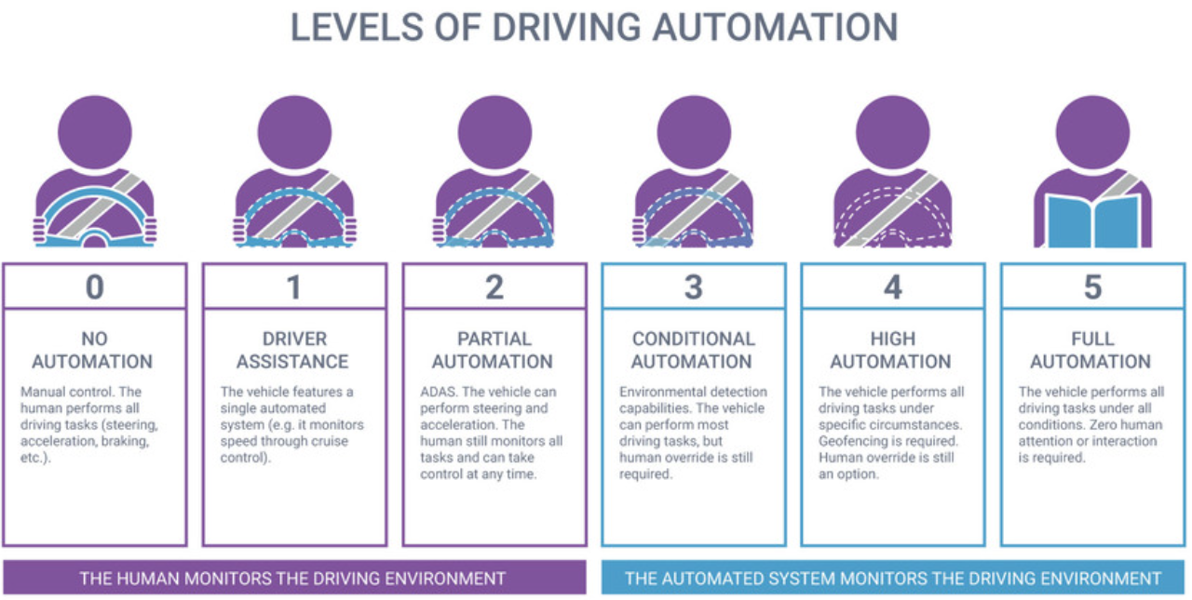
Level of Driving Automation

Slide 26
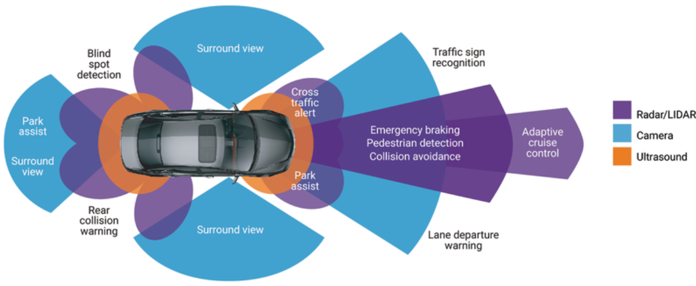
How does ADAS work
Automobiles are the foundation of the next generation of mobile-connected devices, with rapid advances being made in autonomous vehicles.
Autonomous application solutions are partitioned into various chips, called SoCs (systems on a chip).
These chips connect with sensors, actuators through interfaces and high-performance ECUs (electronic controller units).

Slide 27
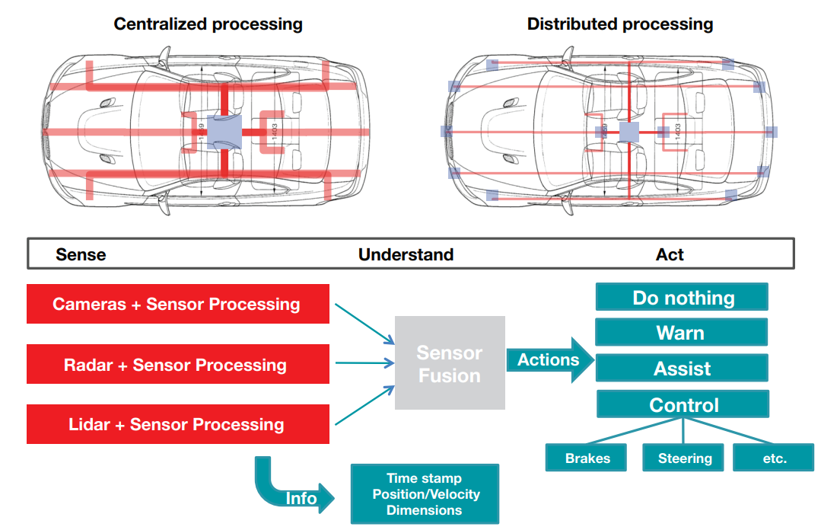
Technical requirements - ADAS evolution

Slide 28
ADAS Applications
ADAS provides support in
Anti-lock braking system ABS
Brake assist
Vehicle dynamics control to prevent swerving and skidding (e.g. ESP)
Automatic speed control, cruise control
Adaptive distance and speed control
Automatic emergency braking system
Lane keeping assist to warn drivers of critical lane changes
Vision enhancement systems (e.g. headlights which swivel when cornering or rain sensors for automatic windscreen wiper actuation)
Driver fatigue detection systems which provide a visual and/or acoustic signal to warn of fatigue and the risk of microsleep.

Slide 29
Driver assistance technologies
Adaptive Cruise Control - Automatically adjusts the vehicle’s speed to keep a pre-set distance from the vehicle in front of it.
Lane Centering Assistance - Provides continual steering to keep the vehicle centered in its lane.
Lane Keeping Assistance - utomatically and gently steers to prevent the vehicle from departing the lane.

Slide 30
Driver assistance technologies
Forward collision warning - Detects a potential collision with a vehicle ahead and provides a warning to the driver.
Lane Departure Warning - Monitors the vehicle’s position within the driving lane and alerts the driver as the vehicle approaches or crosses lane markers.
Rear Cross Traffic Warning - Warns the driver of a potential collision, while in reverse, that may be outside the view of the backup camera.
Blind Spot Warning - Warns of a vehicle in the driver’s blind spot.
Automatic Emergency Braking - Applies brakes automatically when a forward collision is imminent.
Pedestrian Automatic Emergency Braking - Detects a pedestrian in front of the vehicle and automatically applies brakes if a collision is imminent.
Rear Automatic Braking - Detects a potential collision while in reverse and automatically applies brakes if a crash is imminent.

